Slide 1
LC3 Final Project
Khalil Gammoh and Ammon Gruwell

Slide 2
Overview
Test Plan
Test Strategy
Test Bench Block Diagram
Cover groups
Assertions
Tests applied
Bug Report

Slide 3
Test Plan
All opcodes are supported
Instructions can be executed in any order
Instructions can be repeated
A load after a store returns the value previously written
A store command modifies memory correctly
Branching can jump forward or backward
Branching depends on n, z, and p
Any register can be a source
Any register can be a destination
Reset can happen during any clock cycle of LD
Reset can happen during any instruction

Slide 4
Test Strategy
Cover Groups
All opcodes used
All opcodes are preceded and followed by all others
All opcodes are followed by the same opcode
Reset is tested during all cycles of Load
Reset is tested with all opcodes
Branch occurs with N, Z, and P
All opcodes are tested with all SRC1, SRC2, and DST registers
Assertions
Flags aren’t high at the same time
Bus isn’t driven by more that one thing
Registers are 0 after a reset
MemWe is only ever high for one clock cycle
Only store instructions write to memory
Tests
Coverage
Large number of instructions
Different tests for different DUTs

Slide 5
Test Approach Tradeoffs
Memory Model
DUT memory module and golden memory array
Memory locations are randomized at startup
Instructions written to the DUT memory at Fetch
Checking Memory after each instruction
Checking the entire memory took a long time so we only did it when necessary
We check the current memory location only after each instruction
Handling two different DUTs
We created different tests for each DUT which contains a Config flag
Each time a cross module reference is needed we check the Config flag
DUT
TB
RST
Golden Memory
Memory
Monitor

Slide 6
Test Bench Block Diagram
c
Test
Generator
Environment
Driver
Scoreboard
Functional Coverage
Monitor
Assertions
DUT

Slide 7
Program Flow Diagram
Generator
Driver/ Golden Model
DUT
Trans
Instr
State
ScoreBoard
Monitor
State

Slide 8
Bug Report
Date | Time | Minutes to Find/Fix | DUT Owner | Description
12/12/16 | 5:15 PM | 20 | Ammon | Memory out signal was being driven to bus instead of to the MDR
12/14/16 | 10:48 AM | 30 | Ammon | Trap was using the sign extended IR[8:0] instead of the zero extended IR[7:0] and was thus only taking one clock cycle
12/14/16 | 10:58 AM | 2 | Ammon | I was sign extending the trap vector instead of zero extending it.
12/14/16 | 5:54 PM | 2 | Khalil | We added a start state before fetch0 after reset
12/14/16 | 10:48 PM | 2 | Ammon | Reset was not included in memory module
12/15/16 | 1:10 AM | 60 | Khalil | Our enum type was too big so that when it was casted to an int it was getting chopped off
12/15/16 | 1:28 AM | 15 | Khalil | Our JSRR instruction was always using register 0 as its source register
12/15/16 | 2:02 AM | 15 | Khalil | DUT didn’t have reserved or RTI states in it
12/15/16 | 11:00 | 5 | Khalil | DUT was using synchronous resets for the registers

Slide 9
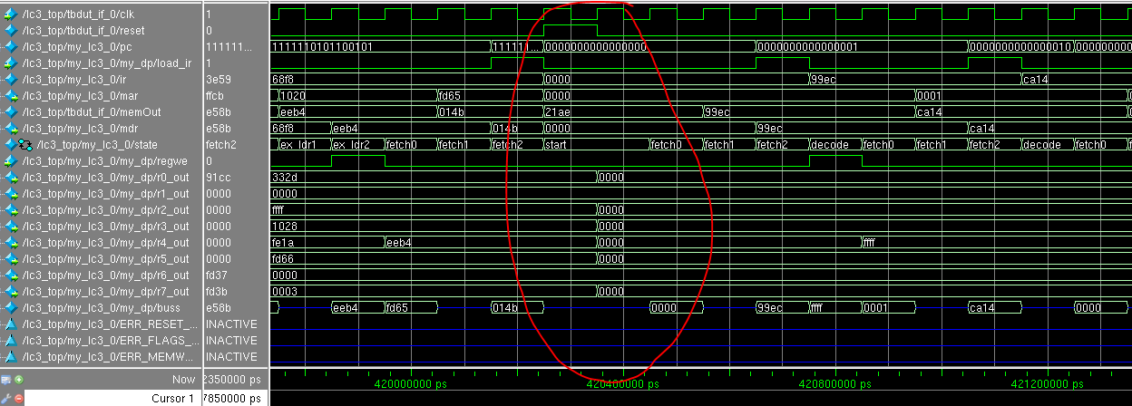
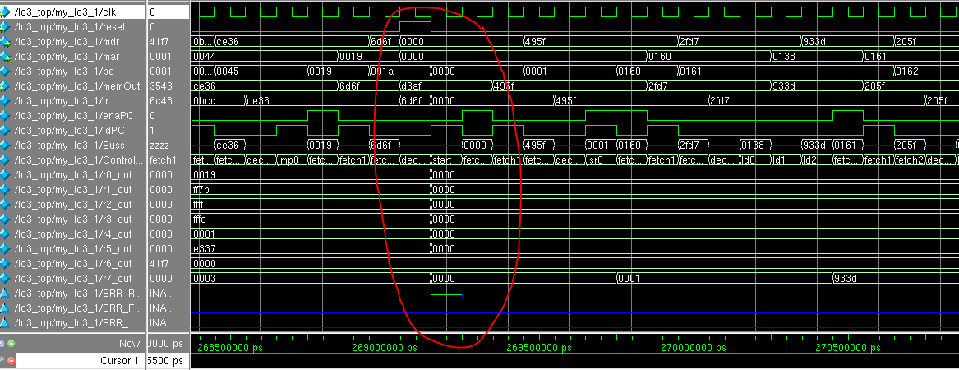
Waveforms
Ammon’s LC3 (showing a reset)
Khalil’s LC3 (showing a reset)

Slide 10
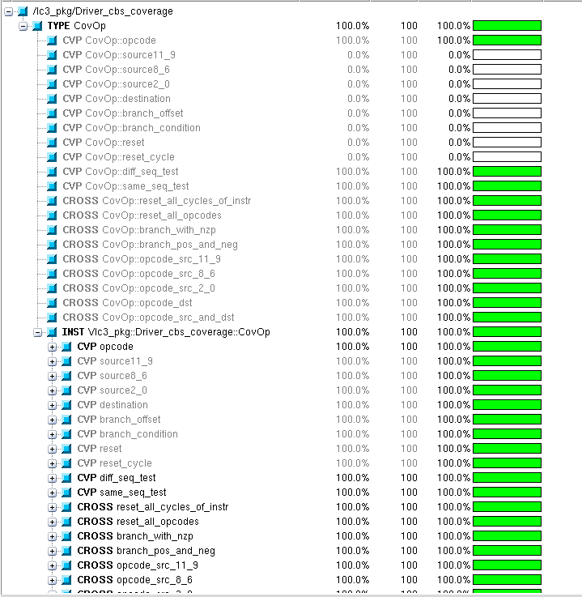
Functional Coverage

Slide 11
Test Output
# // Questa Sim-64
# // Version 10.1c linux_x86_64 Jul 27 2012
# //
# // Copyright 1991-2012 Mentor Graphics Corporation
# // All Rights Reserved.
# //
# // THIS WORK CONTAINS TRADE SECRET AND PROPRIETARY INFORMATION
# // WHICH IS THE PROPERTY OF MENTOR GRAPHICS CORPORATION OR ITS
# // LICENSORS AND IS SUBJECT TO LICENSE TERMS.
# //
# vsim +TESTNAME=TestAmmonCov -do lc3.do opt
# Loading sv_std.std
# Loading work.lc3_top(fast)
# Loading work.test_if(fast)
# Loading work.lc3_pkg(fast)
# Loading work.lc3_tb(fast)
# Loading work.memory(fast)
# Loading work.ammon_lc3_sv_unit(fast)
# Loading work.ammon_lc3(fast)
# Loading work.ammon_lc3_datapath(fast)
# Loading work.register_t(fast)
# Loading work.tristate_driver(fast)
# Loading work.lc32dkhalil2dsv_sv_unit(fast)
# Loading work.MAR(fast)
# Loading work.MDR(fast)
# Loading work.khalil_LC3(fast)
# Loading work.Datapath(fast)
# Loading work.register(fast)
# Loading work.register_1bit(fast)
# Loading work.ControlUnit(fast)
# do lc3.do
# Registering class: TestAmmonCov
# Registering class: TestKhalilCov
# Registering class: TestAmmon
# Registering class: TestKhalil
# lc3_pkg.Factory.get_test found TESTNAME=TestAmmonCov
# lc3_pkg.TestAmmonCov.new
# Built Environment in TestBasic
# 3.6525e+08 Test Coverage reached 100 percent! Exiting test after 68964 instructions...
# ** Note: $finish : lc3_pkg.sv(225)
# Time: 36524950 ns Iteration: 3 Region: /lc3_pkg::Environment::run

